Slide 1
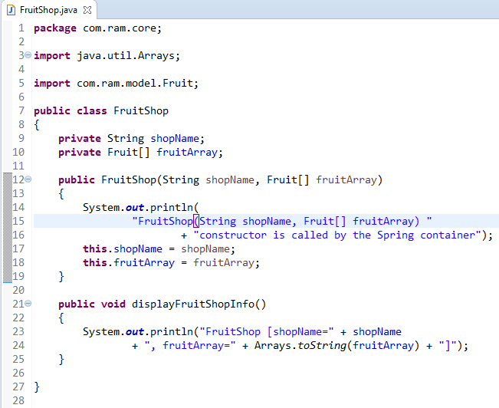
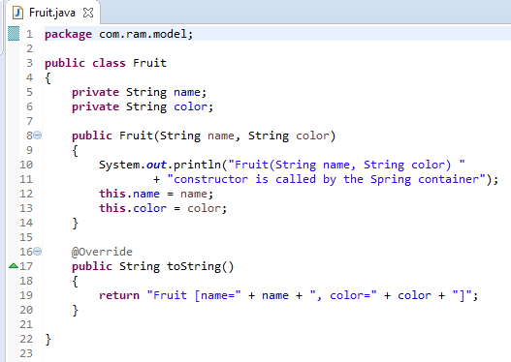
Constructor Dependency Injection with Array having Dependent Object

Slide 2
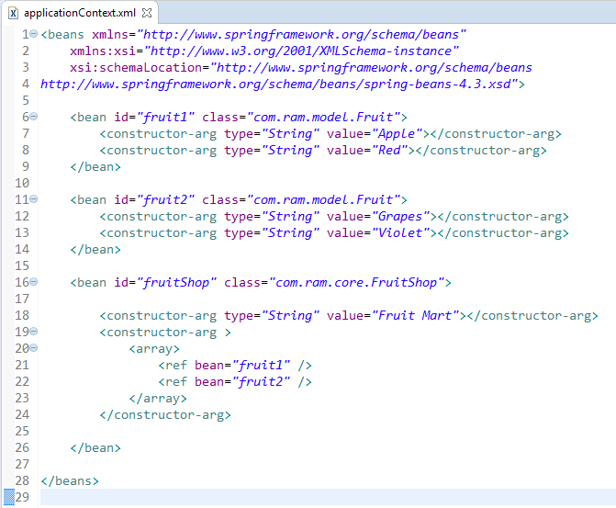
Constructor Dependency Injection with Array having Dependent Object
We are providing the information into the bean by applicationContext.xml file.
The constructor-arg element invokes the constructor. In this example FruitShop(String shopName, Fruit[] fruitArray) constructor will be invoked.
The array element of constructor-arg is used here to define the array.
The ref element is used to define the reference of another bean. Here, we are using bean attribute of ref element to specify the reference of another bean

Slide 3
Constructor Dependency Injection with Array having Dependent Object
FruitShop
What object to instantiate?
What object to configure and how to configure?
The Spring Container
(ApplicationContext)
applicationContext.xml
FruitShop
Object
FruitShop [shopName=Fruit Mart,
fruitArray=[Fruit [name=Apple,
color=Red], Fruit [name=Grapes,
color=Violet]]]
Create the FruitShop object.
Configure the FruitShop object.
Manage FruitShop object complete life cycle from creation till destruction.

Slide 4
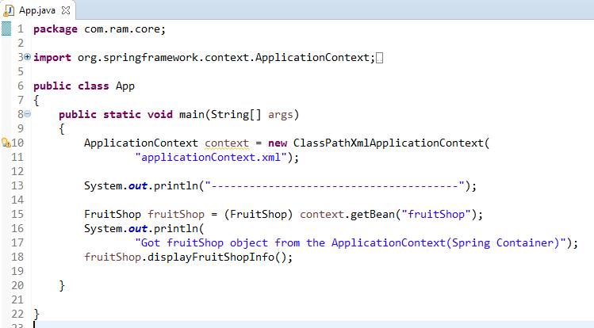
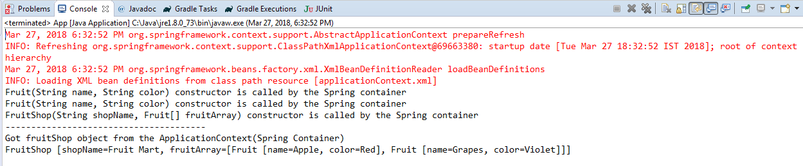
Constructor Dependency Injection with Array having Dependent Object

